Slide 1



Donation Management System
01

Slide 2

The Problem
Managing donations effectively poses several challenges for non-profits and charities. Inefficient record-keeping and data fragmentation lead to errors and inconsistent information. Difficulties in tracking donor details impact personalized engagement, while generating accurate reports and ensuring compliance can be cumbersome. The administrative burden of manual processes is time-consuming, and growing organizations struggle with scalability issues as data and complexity increase.
10

Slide 3

Project overview and SDG alignment.
The Donation Management System streamlines donation processes for non-profits by automating record-keeping and reporting, improving accuracy, and offering actionable insights. This efficiency enables organizations to better allocate resources and focus on supporting communities, directly aligning with SDG 1: No Poverty and SDG 10: Reduced Inequalities. By enhancing operational productivity, it also contributes to SDG 8: Decent Work and Economic Growth, and fosters collaboration through improved data management, supporting SDG 17: Partnerships for the Goals.
06

Slide 4

Donation Management System
##Improved Accuracy
## Better Donor Engagement
## Optimized Fundraising Strategies
## Effective Reporting and Analytics
04

Slide 5



Target Market
Age 13-60
Young Adults (13-60)
95%
Online Users.
123 million
global online buyers and sellers
14

Slide 6
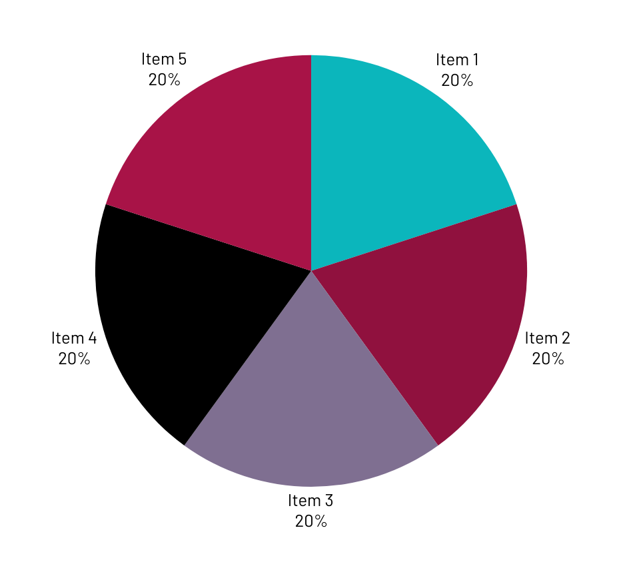
Market Size
The online market is characterized by its expansive reach, catering to a diverse demographic spectrum spanning various age groups, income levels, and geographic locations.

Slide 7

Competitors
Bloomerang
DonorPerfect
NeonCRM
GiveWP
Classy
23

Slide 8

Competitive Advantage
Enhanced Data Integration and Centralization
Advanced Analytics and Reporting
Scalable and Customizable Solutions

Slide 9
Project Traction
Tasks
Month 1
Month 2
Month 3
Month 4
Month 5
Define Target Audience
Value proposition creation
Write your task here
Optimize Market Platform
Content Marketing
SEO (Search Engine Optimization)
Active Marketing
Analytics and Iteration
23

Slide 10

Our system provides detailed analysis of donor engagement patterns, including frequency and recency of donations
2. The system offers comprehensive insights into the effectiveness of various fundraising campaigns.
3. Through advanced analytics, users can monitor donation trends over time and predict future giving patterns.
4.The platform generates in-depth financial reports and compliance documents, offering transparency and accountability.
Data analysis insights
23

Slide 11



Thank you!
amoskesegloria@gmail.com
17

